Slide 1
ELECTION-VOTING-DApp
Blockchain Project…
Tarun - 19bcs036
Param - 19bcs121
Rohit - 19bcs099

Slide 2
Outline
Motive
Problem Statement
Why Blockchain ?
Requirements
Workflow
Improvement in first model
Conclusion
References

Slide 3
Motive
DApp for Election Voting on Ethereum Network.
Aim is to build a Dapp on Ethereum Blockchain, write smart contracts on Ethereum network to conduct the election.
Will be writing tests on ethereum Blockchain and develop a client side application that allows users to cast votes.
On chain - Voters, candidates.

Slide 4
Problem Statement
We'll build a client-side application that will talk to our smart contract on the blockchain. This client-side application will have a table of candidates that lists each candidate's id, name, and vote count. Also provides the option of voting for users. Last election result get displayed.
This project can be a huge boost to the present election system as blockchain provides various aspects like immutability, transparency, cryptographic security services etc.

Slide 5
Why Blockchain ?
Multi party requirement
Y
Trusted Authority
Y
Operation centralized
N
Immutability & transparency
Consider Blockchain
Yes

Slide 6
Requirements
Node Package Manager(NPM): Comes with Node.js
Truffle Framework: Allows us to build decentralized applications on the Ethereum blockchain. It provides a suite of tools that allow us to write smart contacts with the Solidity programming language.
Ganache: Local in-memory Blockchain.
Metamask: Able to connect to our local Ethereum blockchain with our personal account, and interact with our smart contract.
Syntax Highlighting: For solidity Programming.

Slide 7
Workflow
01
Step 1: Smoke Testing
Create foundation for smart contracts. Deploying them and checking if everything is properly set up.
Check in the console after each successful migration to the blockchain.
Ready with your first smart contract, deployed to the blockchain, and retrieved some of its data.
1jhwdpk

Slide 8
Workflow
02
Step 2: List of Candidates
A way to store multiple candidates, and store multiple attributes about each candidate.
Solidity Struct, Solidity Mapping
Adding candidates and migrating them.
Testing the contract in the console.

Slide 9
Workflow
03
Step 3: Client side Application
Building out the client-side application that will talk to our smart contract.
Add Html file along with app.js(web3)
The magic of app.js
Set up web3
Initialize contracts
Render function

Slide 10
Workflow
04
Step 4: Cast votes
Updating the contract by adding voting function
Update Client side work also accordingly.
Test voting function
Take care of Double Voting
Add form for Client side voting

Slide 11
Workflow
05
Display the number of votes and the candidate in majority.
Dealing with front end.

Slide 12
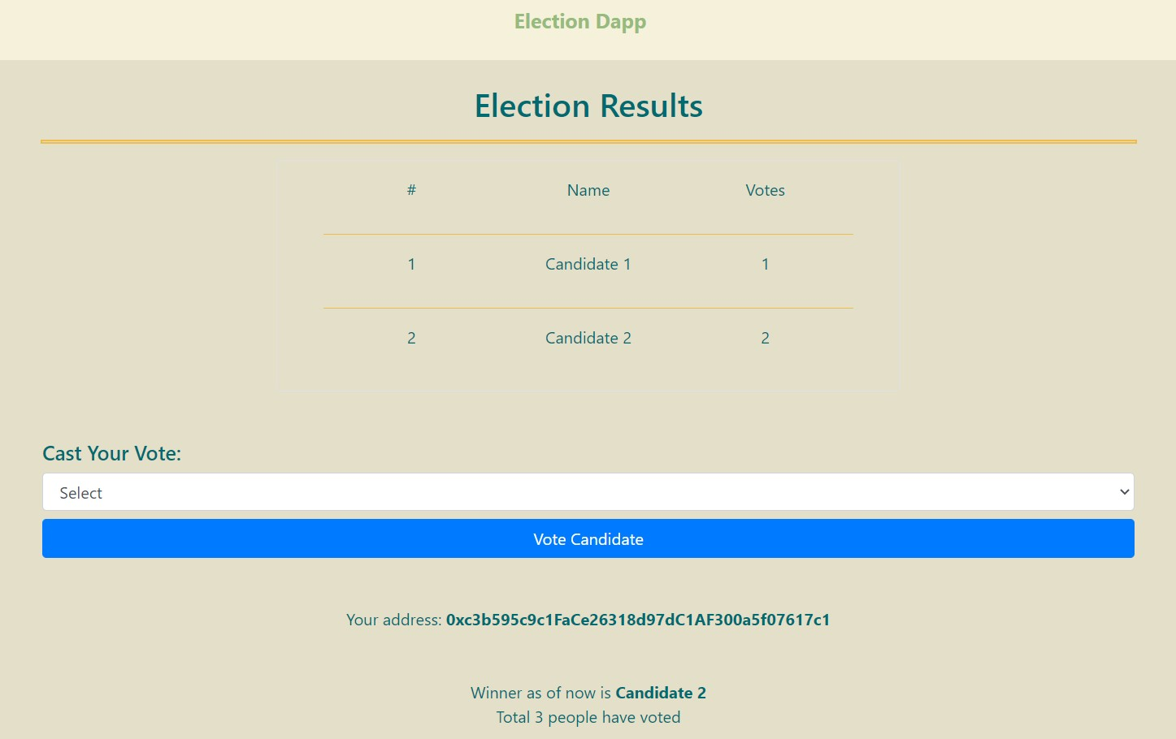
Model

Slide 13
Improvement in above model
How to save Ethereum Dapp users from paying gas for transactions…
Why use ether or txn fee ?
New technique to make voters vote without paying gas. (Elliptic curve digital signature algorithm).
Used in our voting application to save users from paying gas fee without compromising their vote.

Slide 14
Implementation Details
Step1: Sign the message
Step2: Submit the signed vote to the blockchain
Step3: Verify the vote details in the smart contract
Step4: Check the working model with sample data

Slide 15
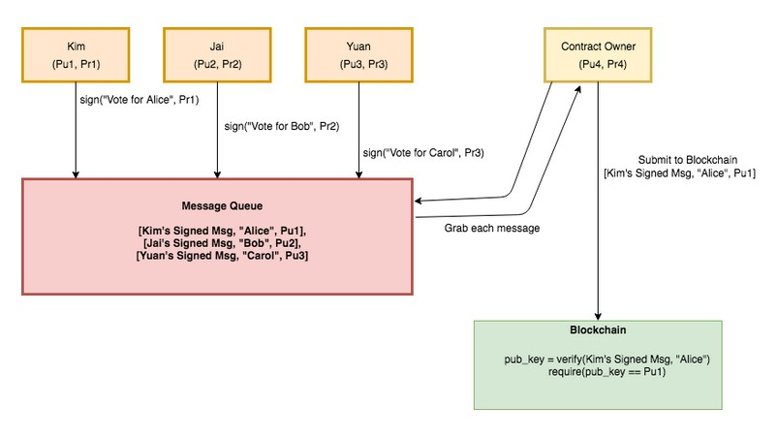
Workflow Diagram

Slide 16
Solution Details
A voter indicates their intention to vote for a candidate by signing a message using their private key. They won’t submit their transaction to the blockchain, so no txn fee is paid. The message queue in the diagram previous is just an off chain location where all the vote details are stored.
Anyone willing to pay txn fee (usually the contract owner) takes the signature, candidate name and voter’s account address and submits them to the blockchain.
The smart contract uses the verify function to derive the public key (Ethereum account address) based on the candidate name and signature. If the derived public key matches the address of the user who signed the message, it records the vote or else fails the transaction.

Slide 17
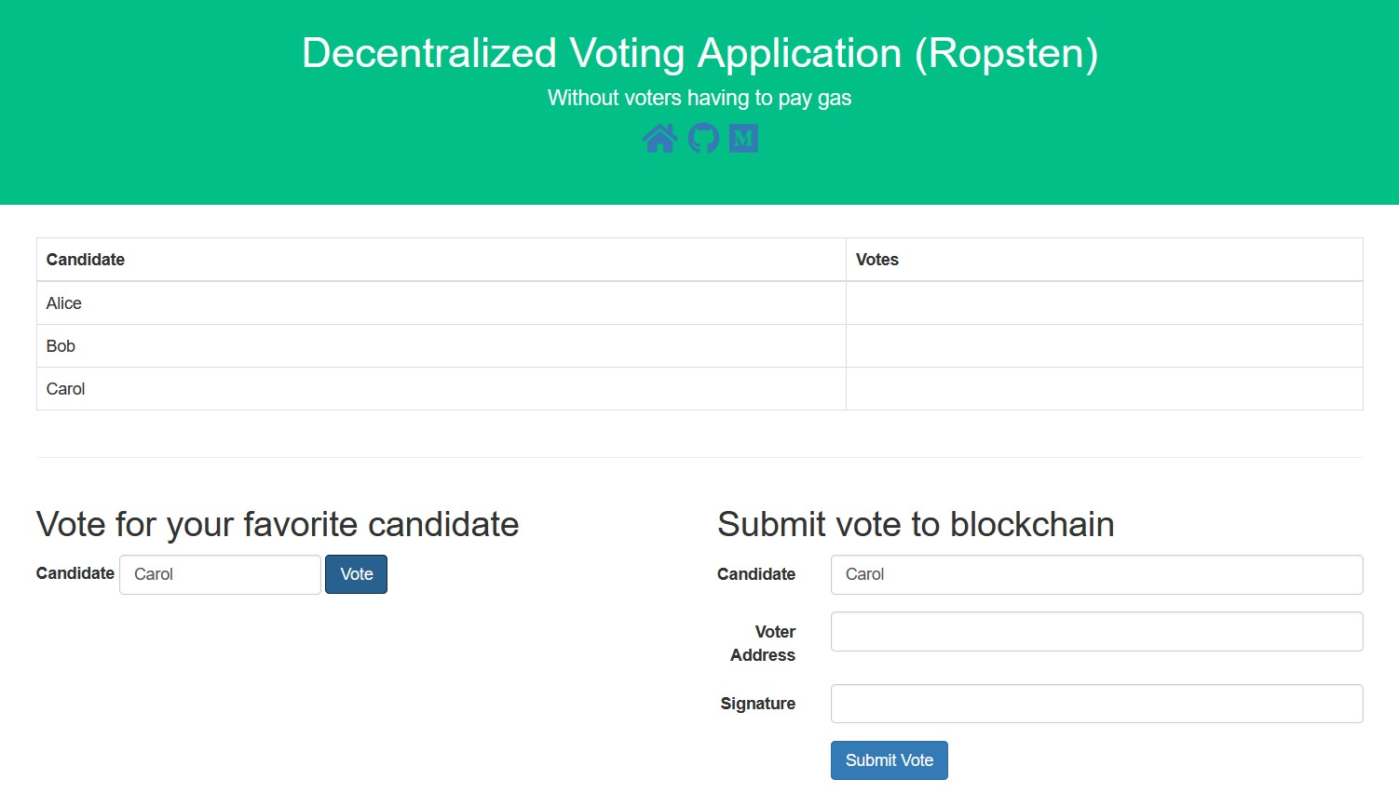
Improved Model

Slide 18
Conclusion
Need for this product in the current situation as blockchain technology used.
Stepwise process flow mentioned to implement.
We did improvement in first model by using DS Algorithm.
Overcoming major challenges in voting system with the help of ethereum network as well.

Slide 19
References
Model 1: The Ultimate Ethereum Dapp Tutorial (How to Build a Full Stack Decentralized Application Step-By-Step) | Dapp University
Improved Model: How to save your Ethereum Dapp users from paying gas for transactions | by Mahesh Murthy | Zastrin | Medium

Slide 20
Thank You!!
Param-19bcs121 Tarun-19bcs036 Rohit-19bcs099

